Slide 1

SAMPLING AND TYPES
SHEHINA.K

Slide 2
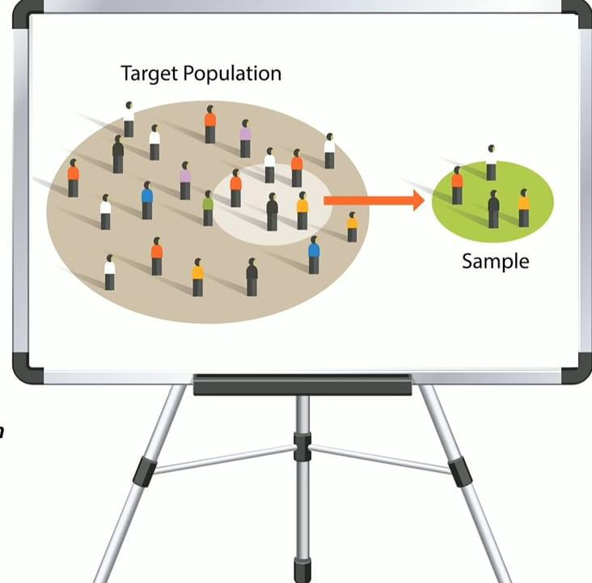
Sample
Sample is a small group of members selected from a population to represent the population
Subset of Population.
SAMPLING
Sampling means selecting the group that you will actually collect data from in your research. For example, if you are researching the opinions of students in your university, you could survey a sample of 100 students. In statistics, sampling allows you to test a hypothesis about the characteristics of a population.

Slide 3

SAMPLING METHODS
NON PROBABILITY SAMPLING
PROBABILITY SAMPLING

Slide 4
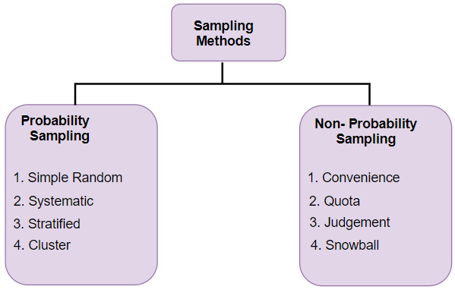

Slide 5
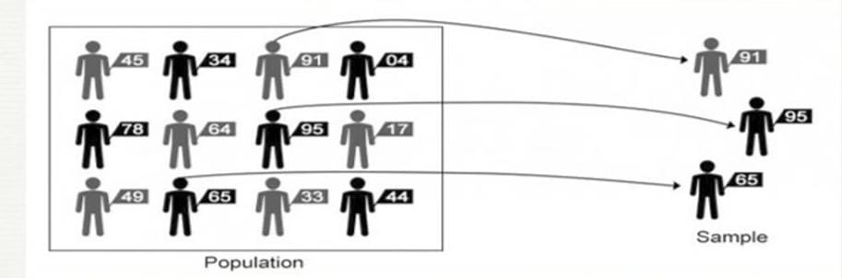
Probability Sampling
Probability sampling means that every individual in a population stands an equal chance of being selected.

Slide 6
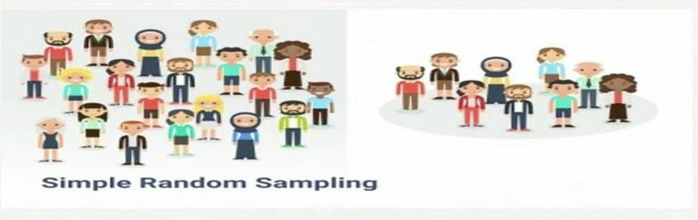
Simple random sampling
The simplest type of probability sampling. A probability sample in which every member of a study population has an equal chance of selection

Slide 7
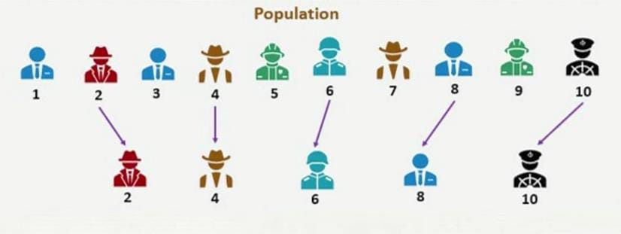
Systematic sampling
The first element is selected randomly from a list or from sequential files, and then every nth element is selected

Slide 8
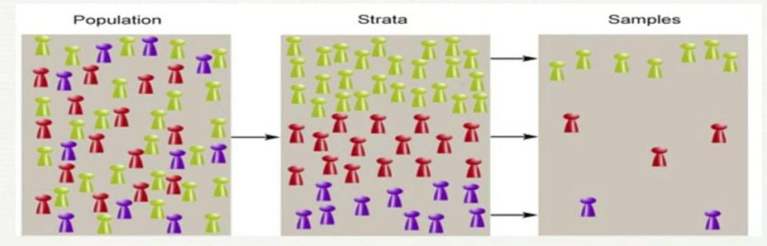
Stratified random sampling
It involves separating the population into subgroups and then taking a simple random sample from each of these subgroups. (strata) based on the relevant characteristic (e.g. gender, age range, income bracket, job role).

Slide 9
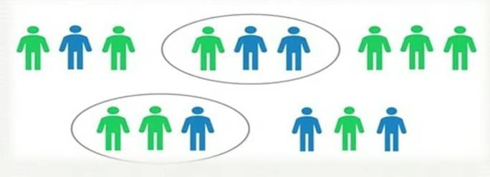
Cluster sampling
It also involves dividing the population into subgroups, but each subgroup should have similar characteristics to the whole sample. Instead of sampling individuals from each subgroup, you randomly select entire subgroups.

Slide 10
Non-probability Sampling
In a non-probability sample, individuals are selected based on non-random criteria, and not every individual has a chance of being included.

Slide 11
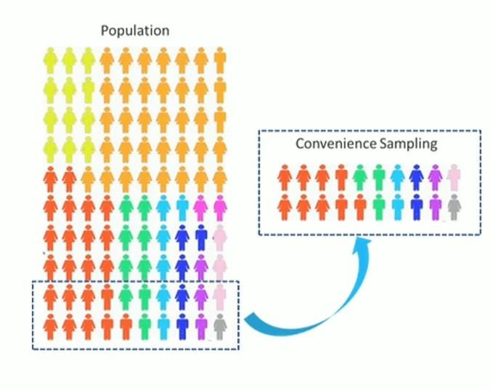
Convenience Sampling
Involves selecting samples based on convenience .Also known as Accidental Sampling

Slide 12
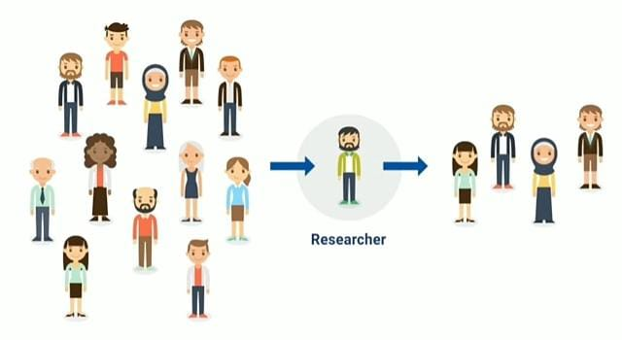
Purposive / Judgmental Sampling
Selecting samples based on his or her own judgement.

Slide 13
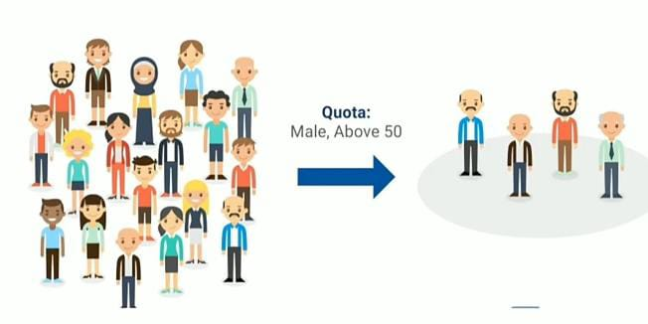
Quota Sampling
Quota sampling means to take a very tailored sample that's in proportion to some characteristic or trait of a population.

Slide 14

Thank You

